Slide 1
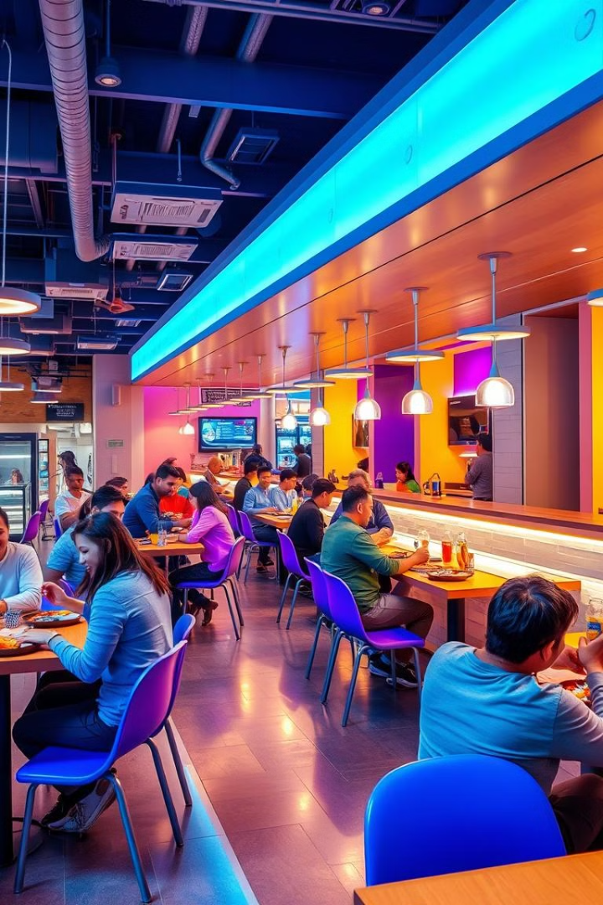
Cafeteria Management System
Welcome! This presentation will explore the development of a user-friendly cafeteria management system, designed to streamline operations and enhance customer satisfaction. We'll dive into its functionalities, design elements, and the technology stack used to create it.
SS
by Sneha Verma, Swathi D, Surya Satvik

Slide 2
Project Abstract
Streamlining Operations
Enhanced Customer Experience
Data-Driven Insights
The system aims to optimize daily operations, from menu planning and inventory tracking to order taking and payment processing.
The system gathers valuable data on customer preferences and sales trends, enabling data-driven decision making.
It provides customers with a seamless ordering process, customizable meal options, and convenient payment methods.

Slide 3
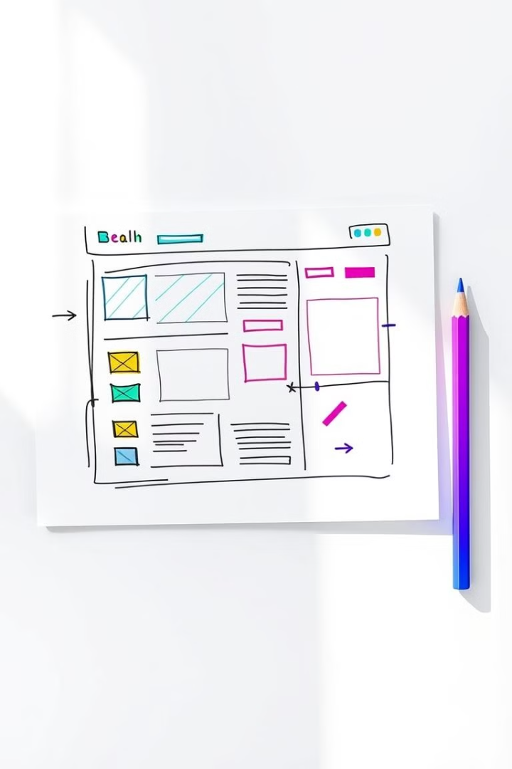
Wireframe Design
Menu Page
Order Page
Displays a list of food and beverage options, categorizes them by meal type, and includes pricing information.
Allows customers to select items, customize orders, and view a running total.
Payment Page
Admin Dashboard
Provides multiple payment options, including credit/debit cards and mobile wallets.
Provides an overview of sales data, inventory levels, and customer feedback.

Slide 4
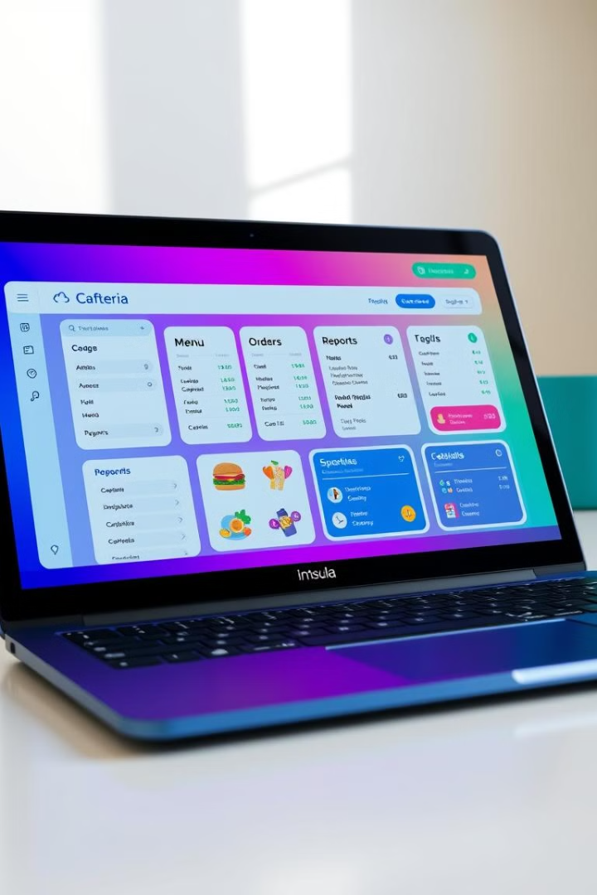
Key Modules and Web Pages
Menu Management
Order Management
Allows staff to create, update, and remove menu items, set prices, and manage categories.
Processes customer orders, tracks order status, and enables easy order retrieval.
Inventory Management
Reporting and Analytics
Tracks ingredient levels, sets reorder points, and generates reports on inventory usage.
Provides valuable insights into sales trends, customer preferences, and operational efficiency.

Slide 5
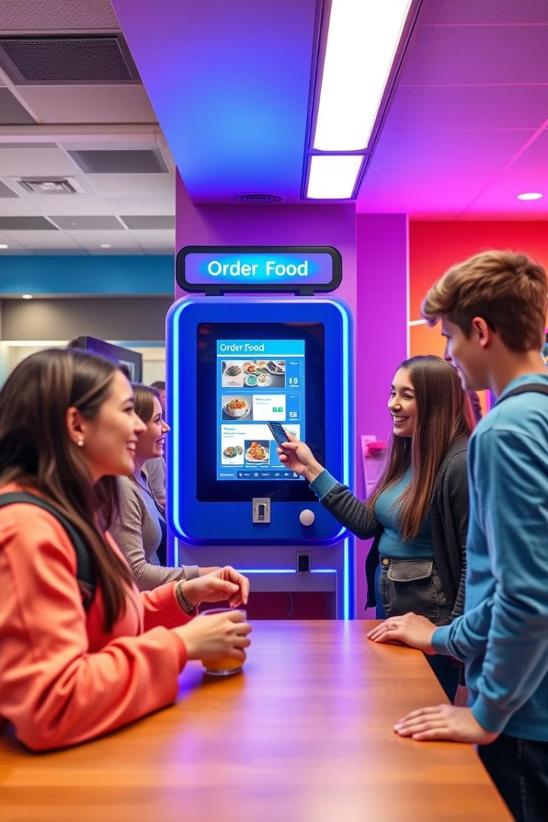



Use Case Scenarios
Customer Ordering
A customer browses the menu, selects items, customizes their order, and makes a payment.
Staff Management
A staff member updates the menu, tracks inventory, and generates sales reports.
System Administration
An administrator configures system settings, manages user accounts, and monitors system performance.

Slide 6
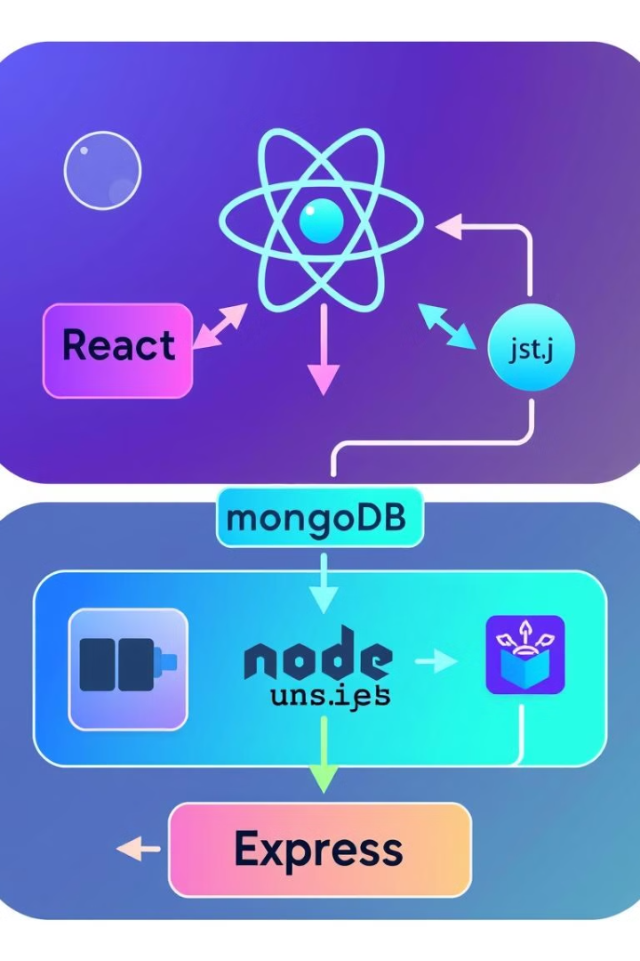
Technology Stack
1
Front-end: React
ReactJS was chosen for its speed, efficiency, and ease of use in building dynamic user interfaces.
2
Back-end: Node.js and Express
Node.js and Express provide a powerful and scalable framework for handling server-side logic and API endpoints.
3
Database: MongoDB
MongoDB was selected for its flexibility, scalability, and efficient handling of large datasets.

Slide 7




Front-end Fundamentals: HTML, CSS, JavaScript
HTML
Used to structure the layout and content of web pages.
CSS
Provides styling and visual presentation for web pages.
JavaScript
Adds interactivity and dynamic functionality to the user interface.

Slide 8

Conclusion and Next Steps
This cafeteria management system is a powerful tool that can help streamline operations, enhance customer satisfaction, and provide valuable data-driven insights. Future development will focus on integrating additional features, such as online ordering and customer loyalty programs.

Slide 9
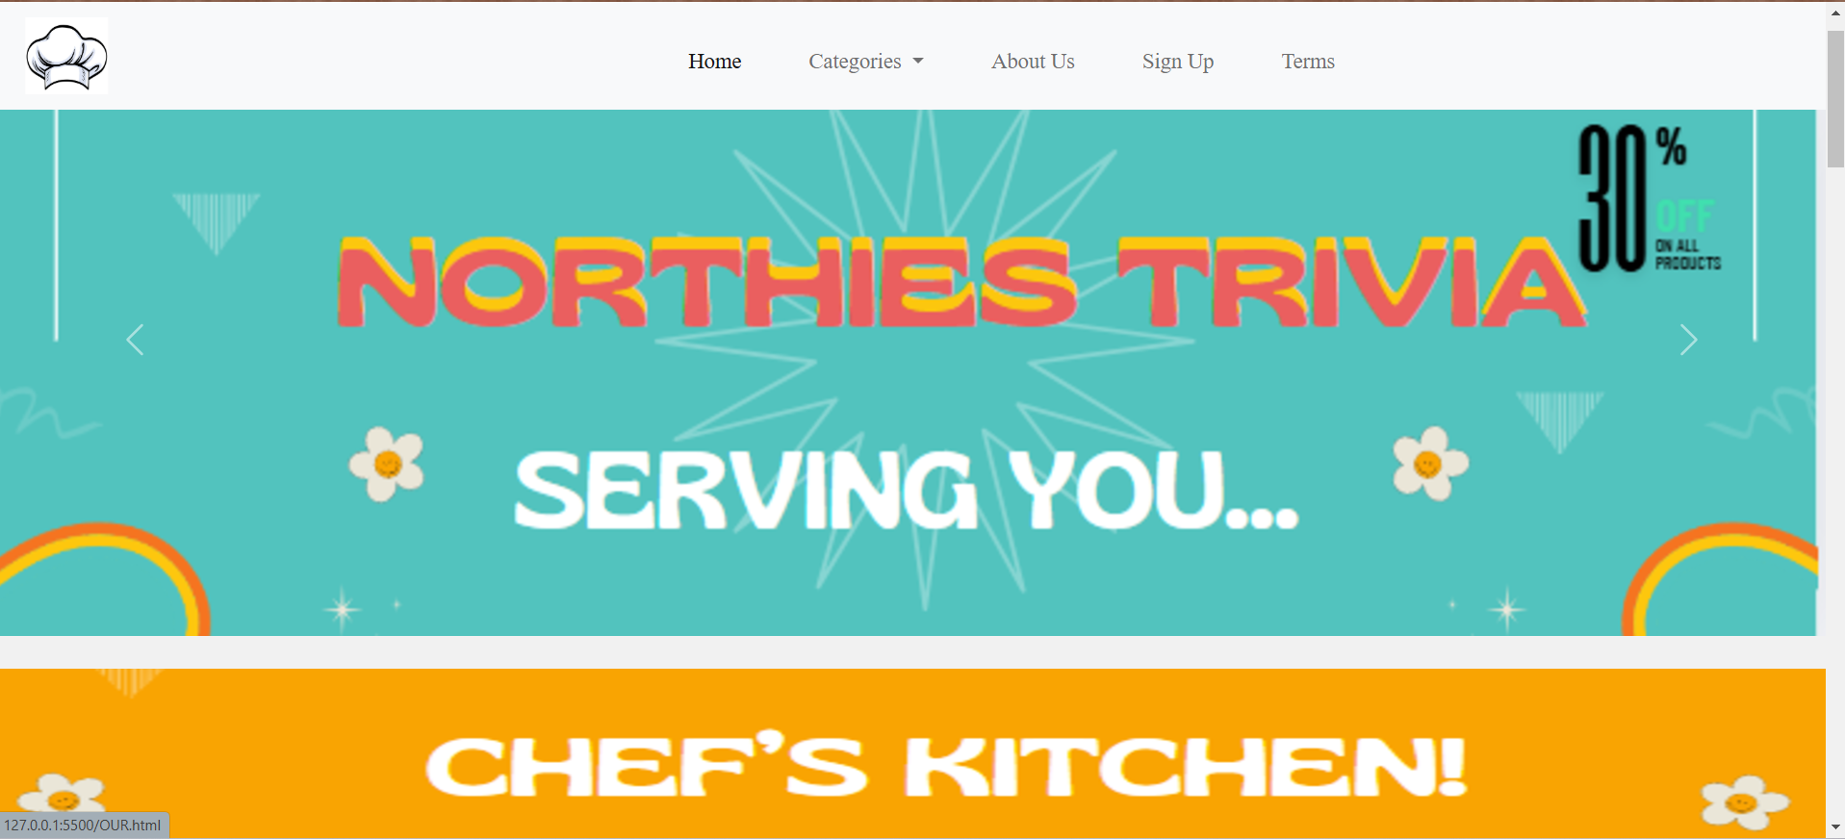
OUR WEBSITE HOME PAGE:
OUR HOMEPAGE

Slide 10
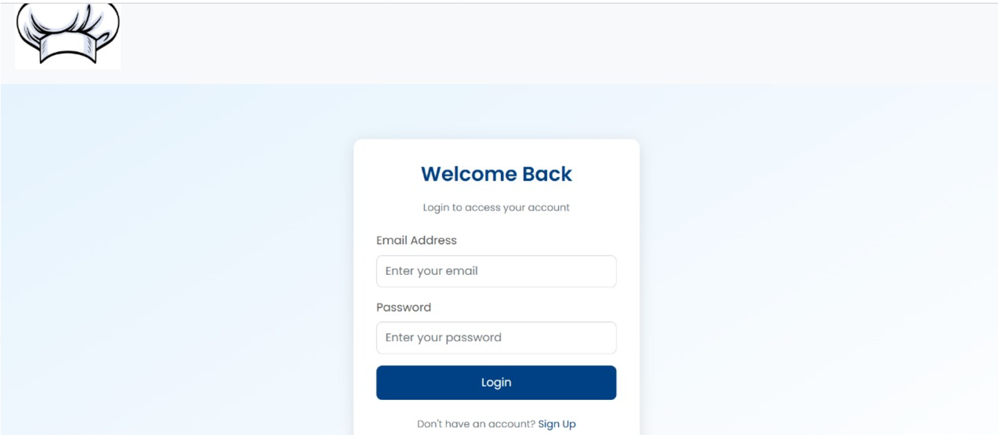
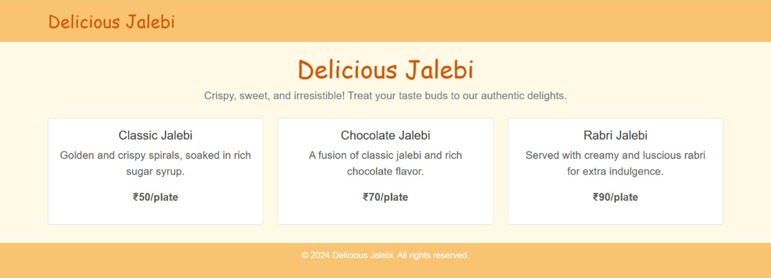
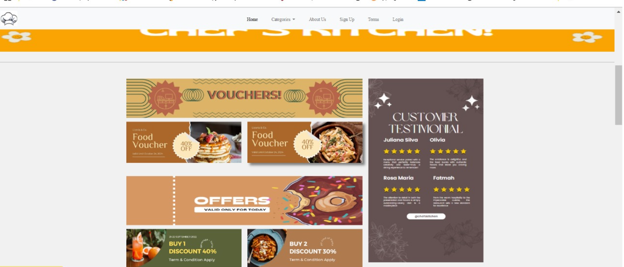
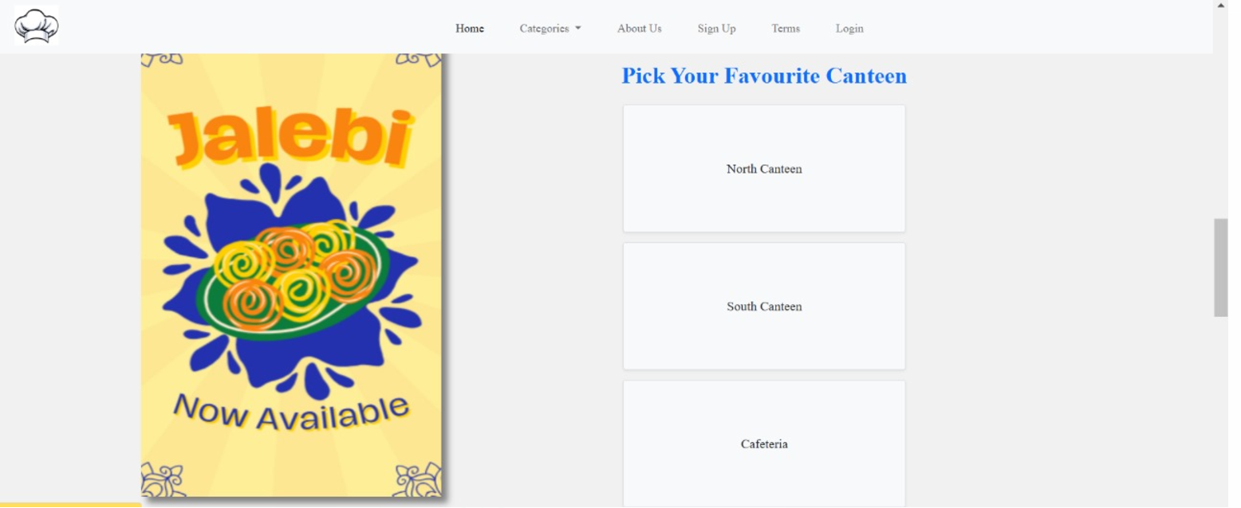
Pictures of our website

Slide 11
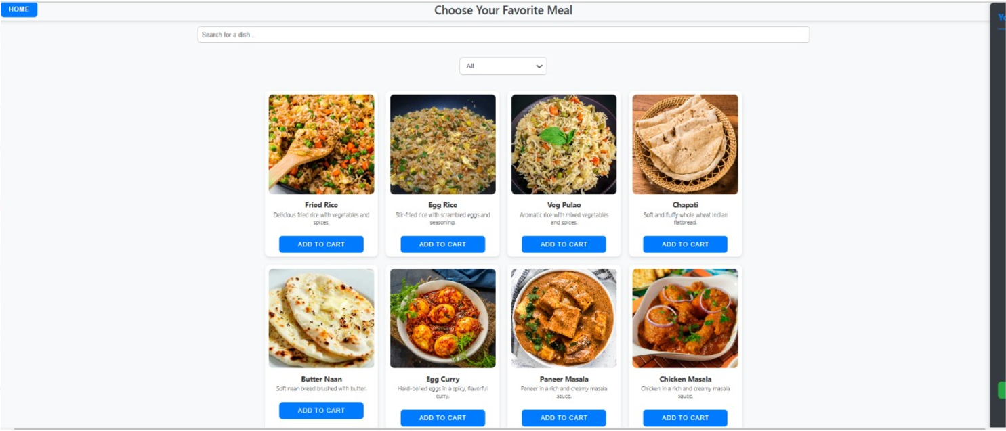
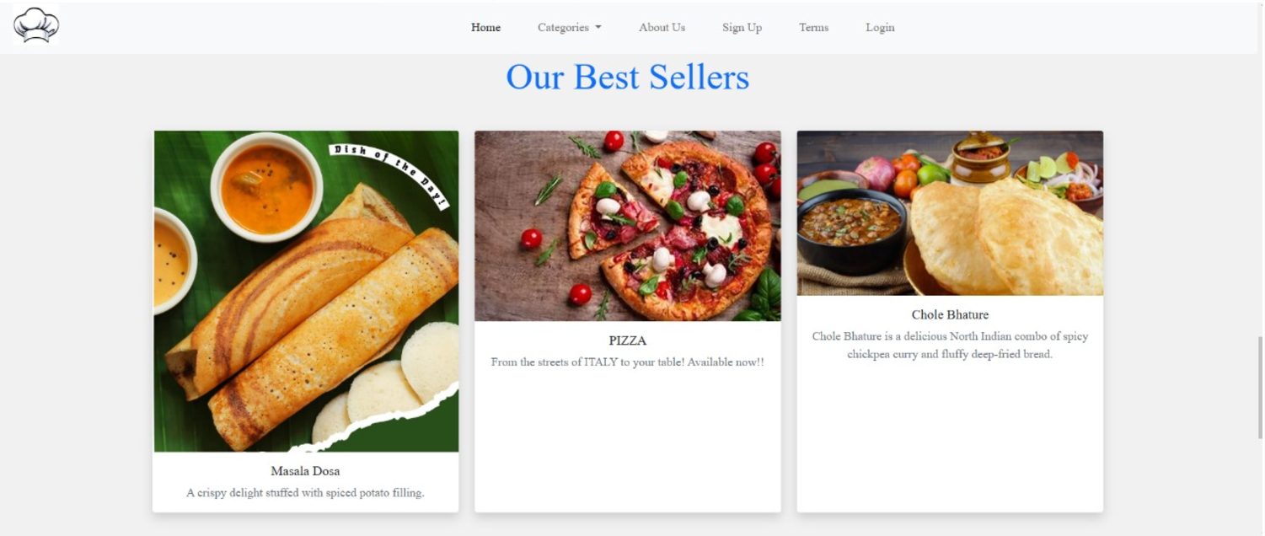
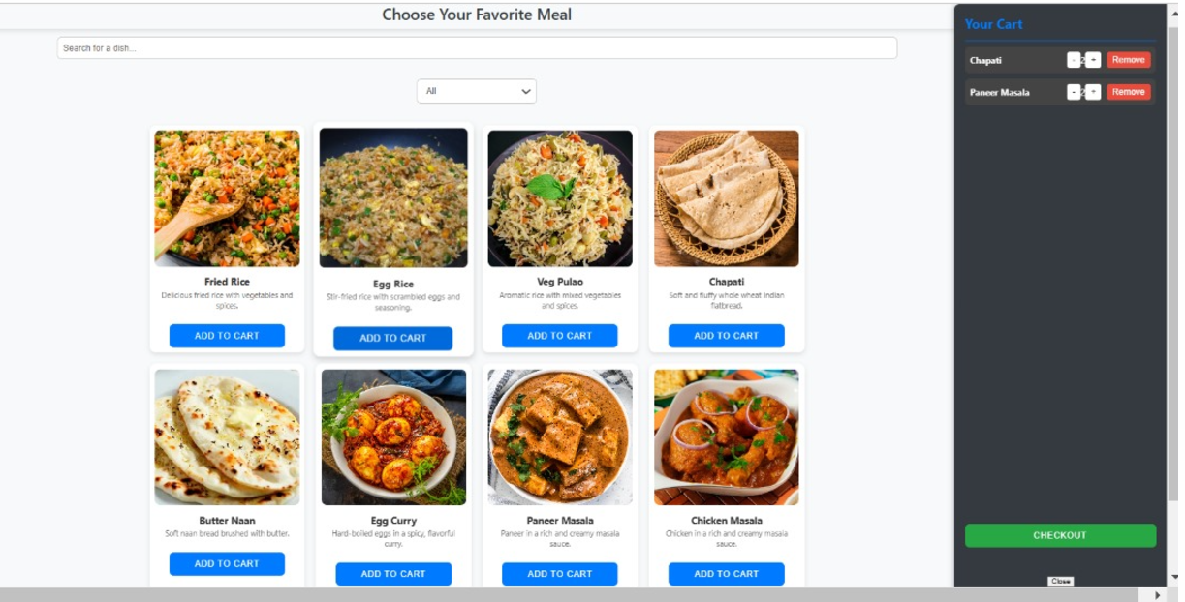
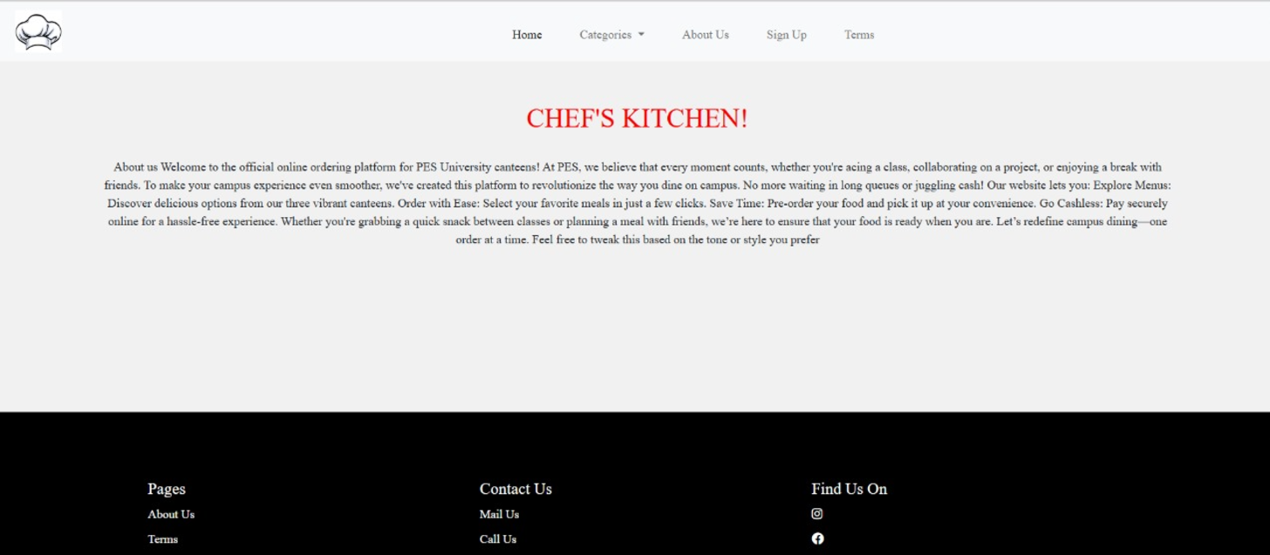

Slide 12
